Slide 1
Capstone Project- 1
EDA on Airbnb booking
By
Individual -
Sagar Aggarwal

Slide 2

Problem Statement
For this project we are analyzing Airbnb’s New York City(NYC) data of 2019. NYC is not only the most famous city in the world but also top global destination for visitors drawn to its museums, entertainment, restaurants and commerce.
Our main objective is to ﬁnd out the key metrics that inﬂuence the listing of properties on the platform. For this, we will explore and visualize the dataset from Airbnb in NYC using basic exploratory data analysis (EDA) techniques.
Data analysis on thousands of listings provided through Airbnb is a crucial factor for the company.
We will be ﬁnding out the distribution of every Airbnb listing based on their location, including their price range, room type, listing name, and other related factors.

Slide 3

Understanding the Data
There are 49,000 observations with various types of field in our dataset.
List of field:
Id
Name
Host_id
Host_name
Neighbourhood_group
Neighbourhood
Latitude
Longitude
Room_type
Price
Minimum_nights
Number_of_reviews
Last_review
Reviews_per_month
Calculated_host_listing_count
availabilty_365

Slide 4

Agenda
We try to answer following questions for Airbnb:
What is the average preferred price by customers according to the location , different areas of different room ?
Which is the most enganging and disengaging location ?
Where the customer pays the highest and lowest rent according to location?
Who are the top hosts based on their turnover?
Where the total number of nights spend per location?
Most popular/demanded host of Airbnb in New York

Slide 5
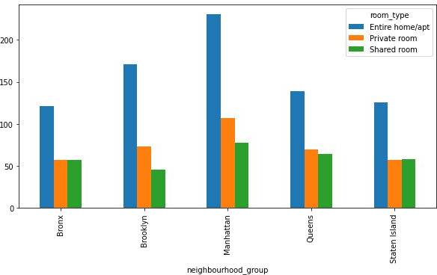
What is the average preferred price by customers according to the location , different areas of different room ?
As we can see in Manhattan average price of Entire home/apt is highest, compared to other location.
Average price of shared room is lowest in brooklyn.
Queens, Staten Island and Bronx share almost the same price i.e $50 for Shared room and Private room.

Slide 6
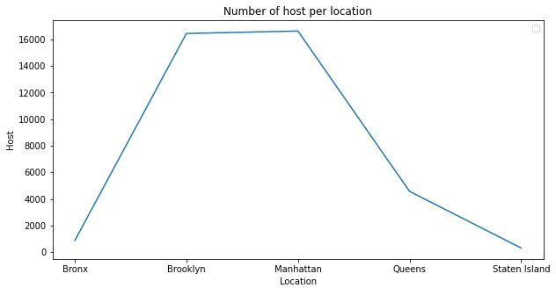
Which is the most enganging and disengaging location ?
Manhattan and Brooklyn is the most preferred place by hosts.
Bronx and Staten Island is low traffic for host as compared to other location
Queens has a average number of host.

Slide 7
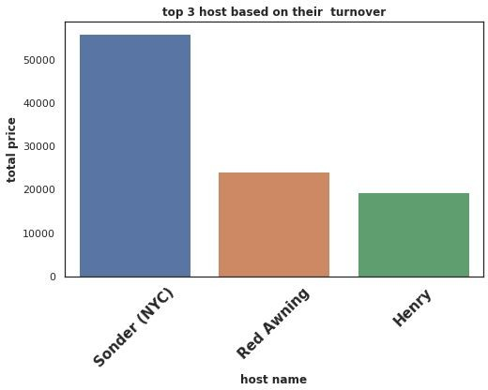
Top three hosts based on their turnover
Here we are trying to find top three host based on their turnover and compare between those three hosts.
We can state that Sonder(NYC) is the top host based on his high turnover.Red Awning and Henry secured 2nd and 3rd position respectively.
Total turnover of Sounder(NYC) is more than 50000$. Red Awning and Henry is quite behind from the 1st place.

Slide 8
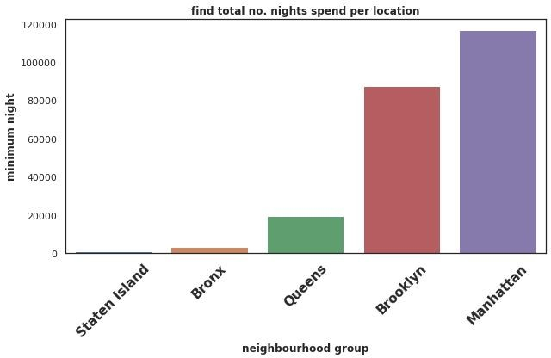
Find total no. nights spend as per location
The locations based
are on its total
categorized number of spend by
minimum customer.
nights
From here we can get an overall idea of which location the customer prefers more.
We can state that more customers prefer Manhattan and Brooklyn for night stay as compared to other locations.

Slide 9
Challenges Faced
Reading the dataset and understanding the meaning of some columns.
For answering some of the questions we had to understand the business model of airbnb that how they work.
Handling NaN values,null values and duplicates.
Designing multiple visualizations to summarize the information in the dataset and successfully communicate the results and trends to the reader.

Slide 10

We defined some points which can help airbnb in their business:
Analysis Summary:
Manhattan is the most focused place in New York for hosts to do their business
Customers pay highest amount in Brooklyn,Queens and Manhattan that is $10,000 and lowest amount is
$10.
For the three types of room type (i.e. Entire home, Shared room, & Private room) average price of entire home is around $157, for Shared room is around
$60, and for private room is around $75.
Top three host base on their turnover are Sonder(nyc),Red awning, Henry and best host is Sonder(nyc)

Slide 11
Analysis Summary (contd.):
People stay for longer duration of time in Private rooms in Brooklyn and Manhattan.
More customer preferred Manhattan location for night stay than Brooklyn

Slide 12
Thank you
Sagar Aggarwal

